Slide 1
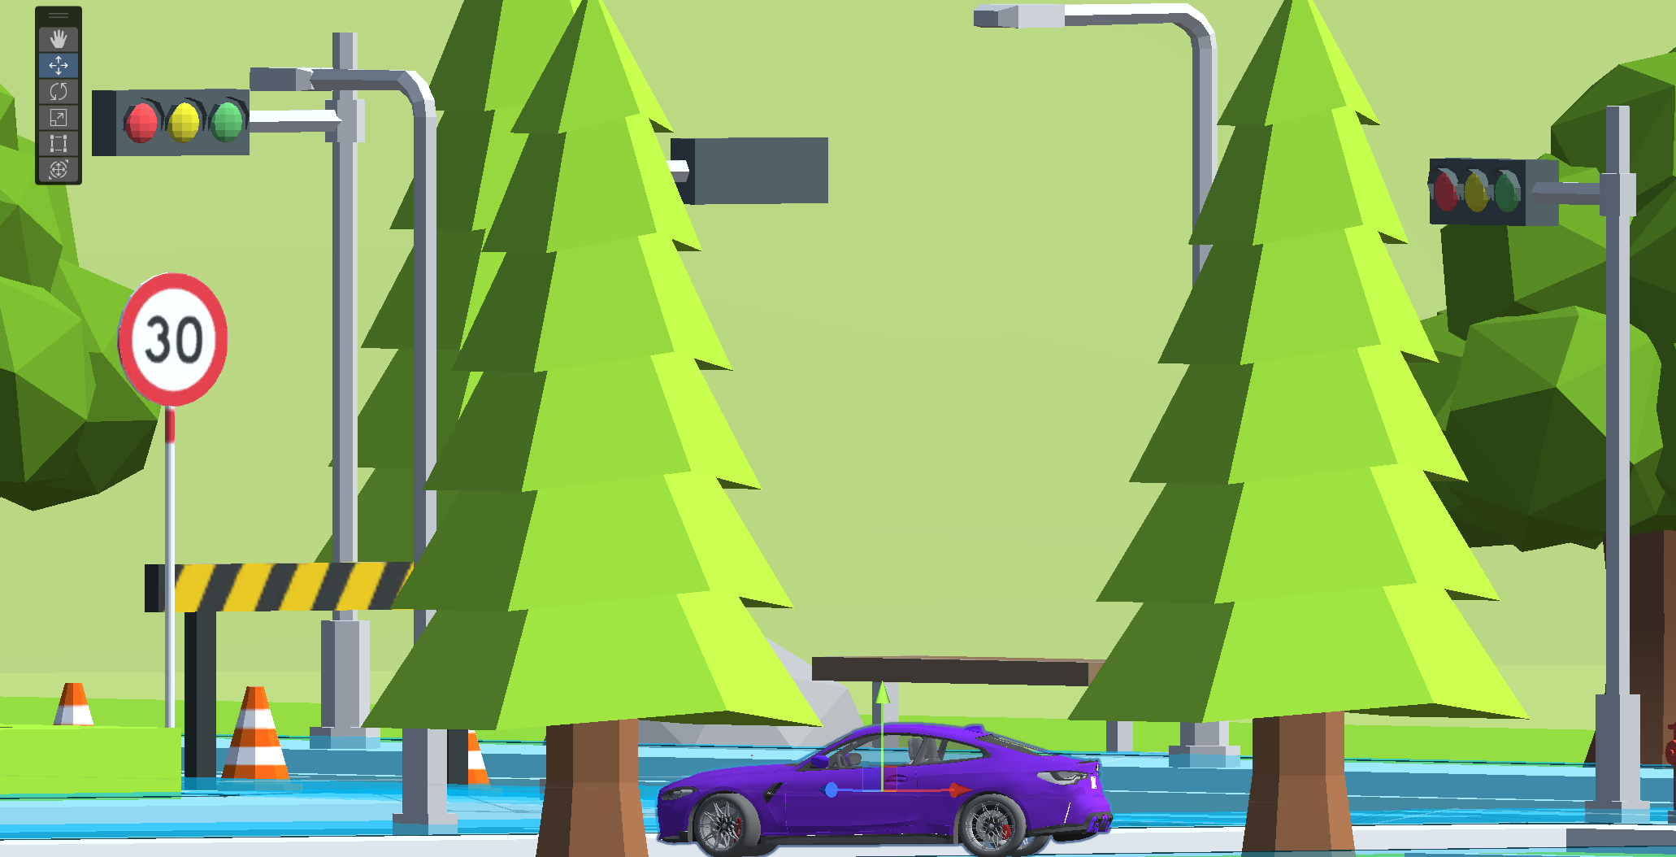
YB-Driving Vision-based Autonomous Driving Simulator
Project Report
Supervisory team:
Zhenqun Sheng, XiangWen Tian, Dingqi Zhang
Master of Software Engineering, 2023,
Yoobee College of Creative Innovation, Auckland

Slide 2
Team3 - 3Tives Innovative, Imaginative, Productive
Frank (Zhenqun Shen)
Unity3D
(Environment)
Bill (XiangWen Tian)
Research Study
Nathan (Dingqi Zhang)
Python
(agent/model)

Slide 3
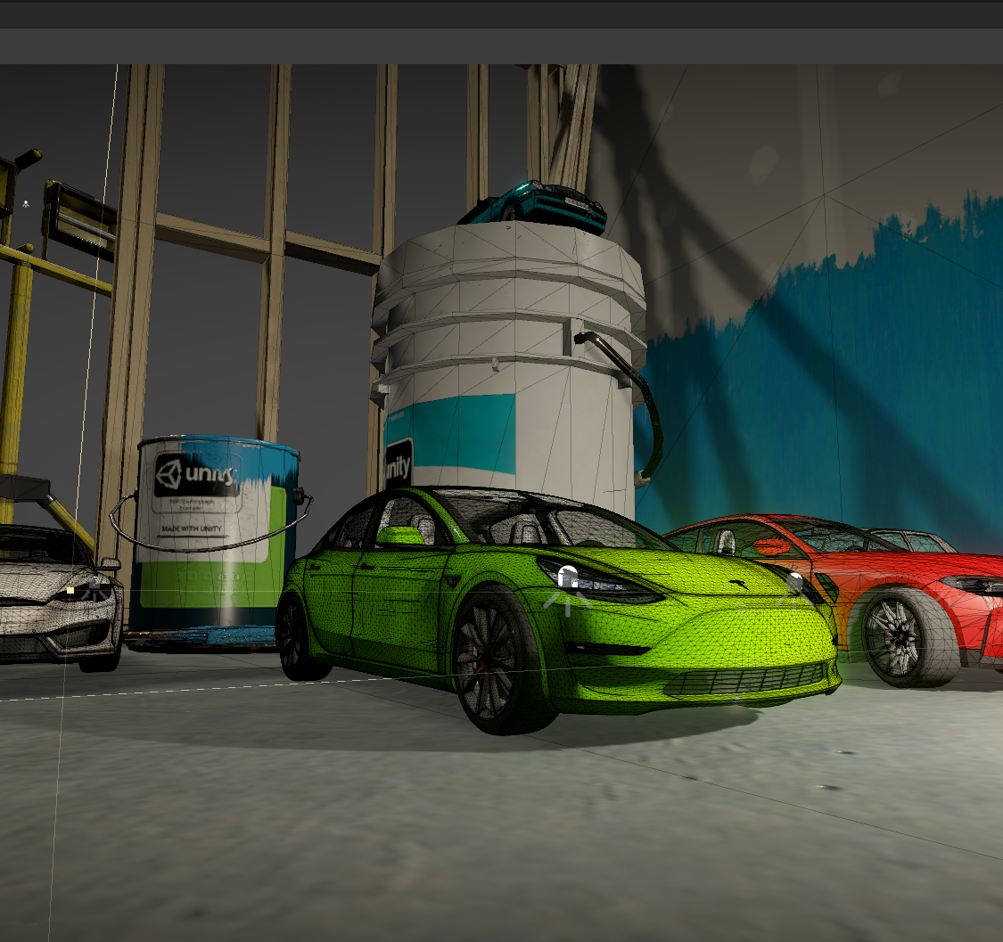
Project Report
Introduction
Application & Value
Existing Solutions
Requirements & Targets
Techniques & Solution
Results & Conclusion
Future Development
Issues and Leaning

Slide 4
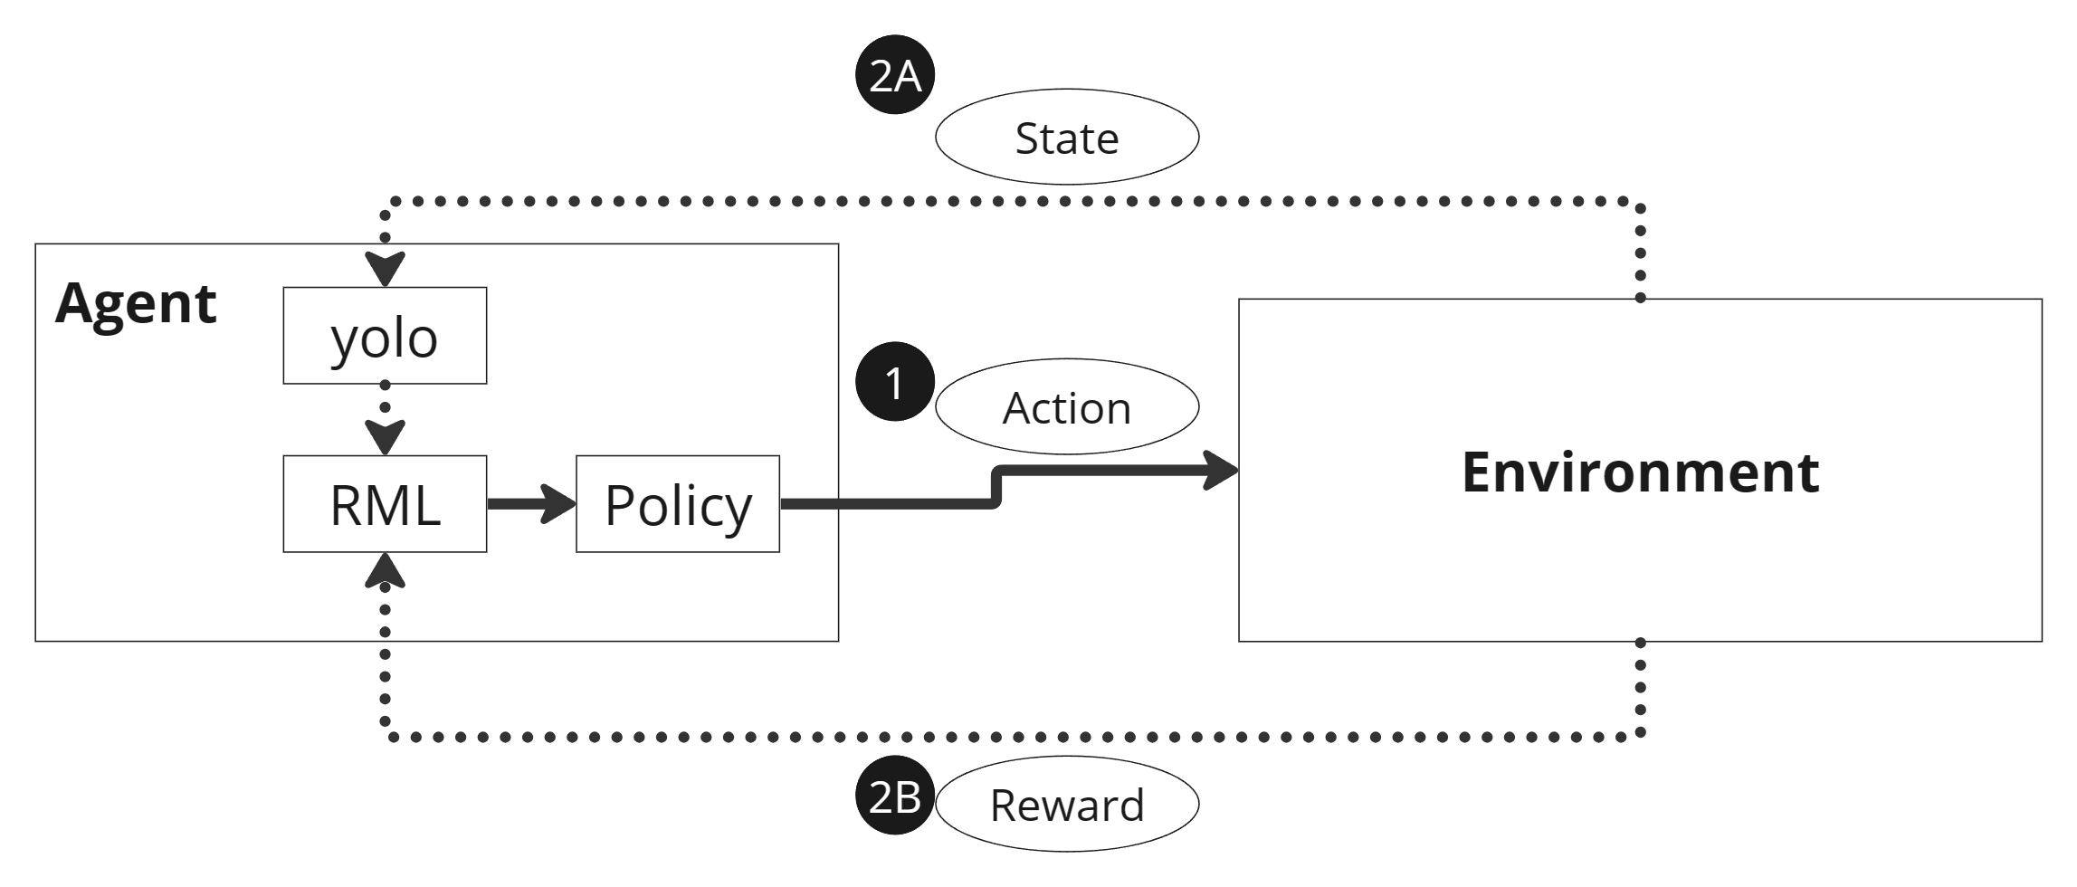
Introduction – Principal
Ego-only Systems vs Connected Multi-agents Systems
Modular Systems vs End-to-end Systems
Direct supervised deep learning
Neuro Evolution
Deep Reinforcement Learning
Deep Q Networks
Lack of hard-coded safety measures

Slide 5
Introduction
Autonomous Driving
Autonomous Driving simulator
3D Graphic Engine
LiDAR
Machine Learning Agent (python/c++)
Deployment
Virtual Environment
RADAR
Natures
Vision
Vehicles
Learn
Sensors
Detectors
Communication
Road/sign
Predict
Computation
Buildings
Action
Control
Rendering System
Physic System
Punish
Plugins
Editor/Scripts
Reward
Simulation & Learning Hardwares
Embedding Devices

Slide 6
Applications & Value
Zero physical machine required
Cost efficiency
Safety
Data availability and accessibility

Slide 7
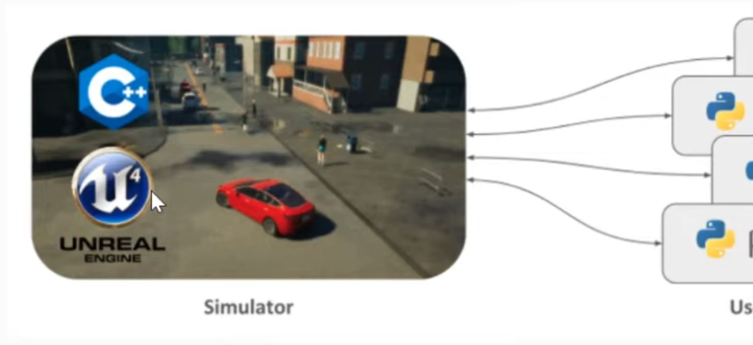
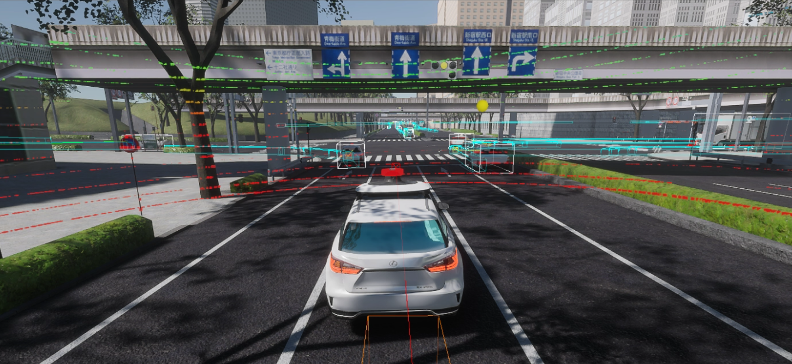
Existing Solutions
Unity+LGSVL
Unity+AriSim
Carla+Unreal
Autoware+AWSIM
Nvidia Drive SIM

Slide 8
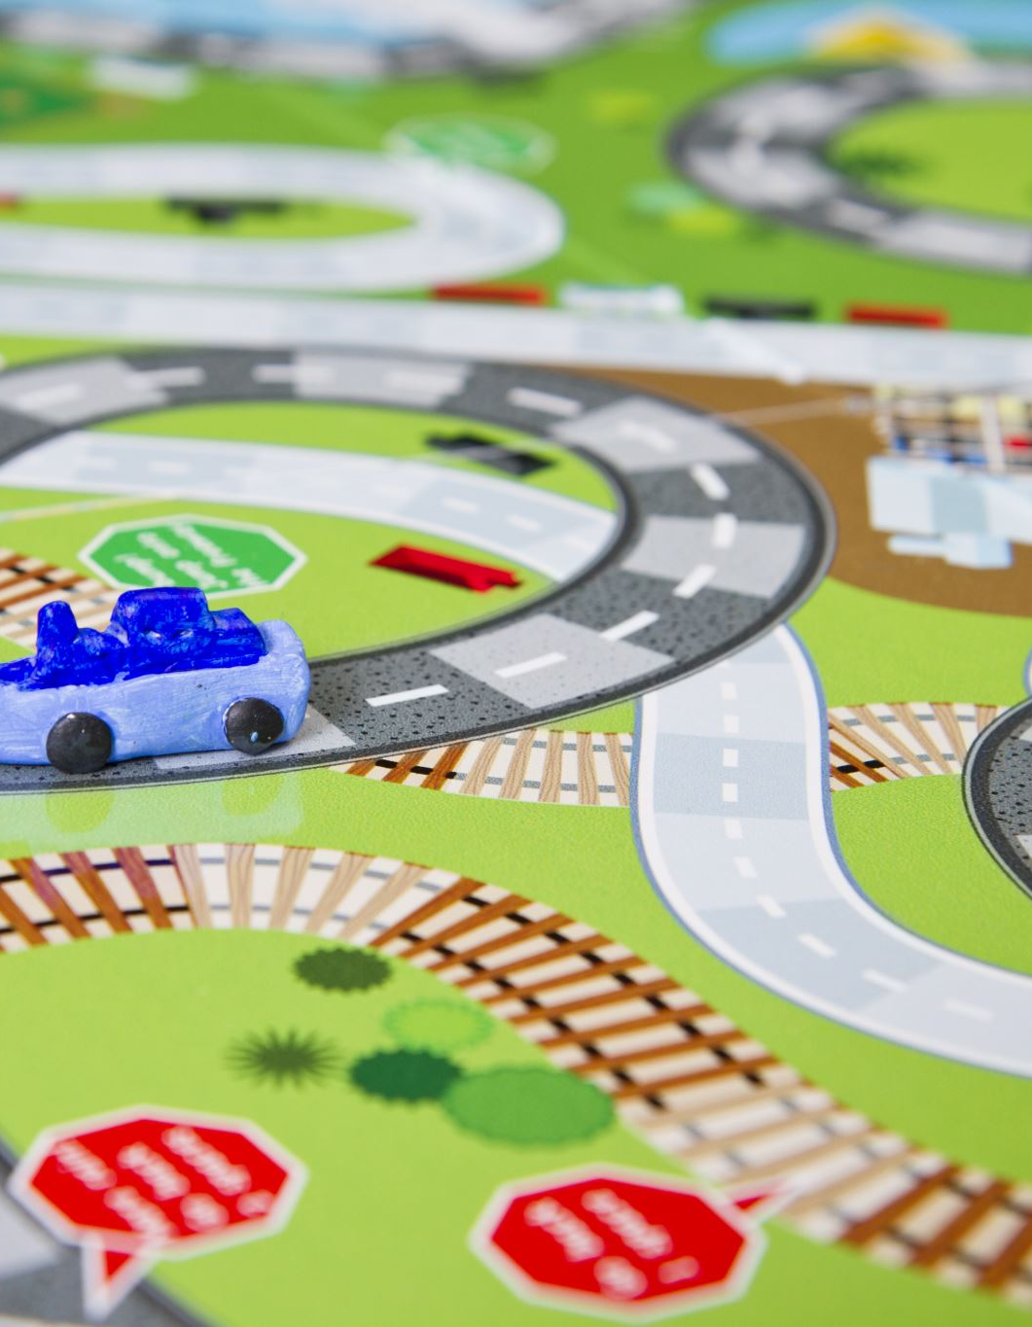
MSE806 Project Targets
Build up a framework of train-test-verify
Traffic sign detection and recognition
Optional
control – speed limit control
control – lane maintain
control – vehicle detection and collision avoidance
control – pedestrian detection and collision avoidance

Slide 9

Major Challenges
RL Model choosing
Changing object size (temporal signal)
Feature selection
Training/inference effectiveness
Multi-object tracking and recognition
Award/punish mechanism design
Coding
Batched-Online learning
Multi-agents learning

Slide 10
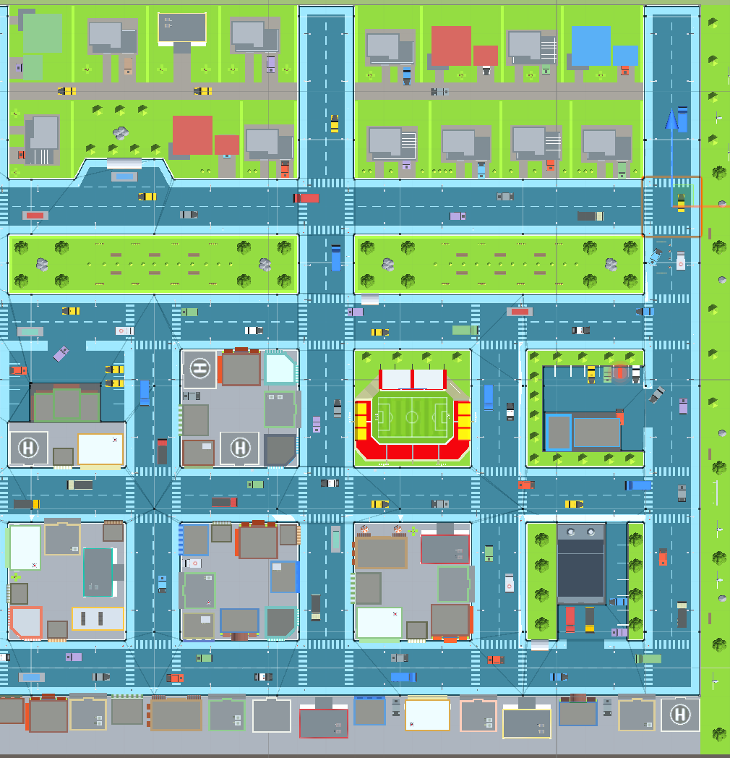
Our Solutions
Overall framework
Unity 3D engine – virtual town (300x300m )
Navigation - Unity NavMesh
Vision-based Object detection and recognition
Viola-Jones Algorithm, 2001
R-CNN, 2014
Fast R-CNN & Faster R-CNN, 2015
Mask R-CNN, 2017
Yolo, 2016, Yolo family, Yolov8 and fine-tuning
Torchvision
meta segment anything
Vision-based Reinforcement learning
Q-Learning 2013
Linear_QNet (DQN) 2015
Double Q-Learning
LSTM algorithms

Slide 11
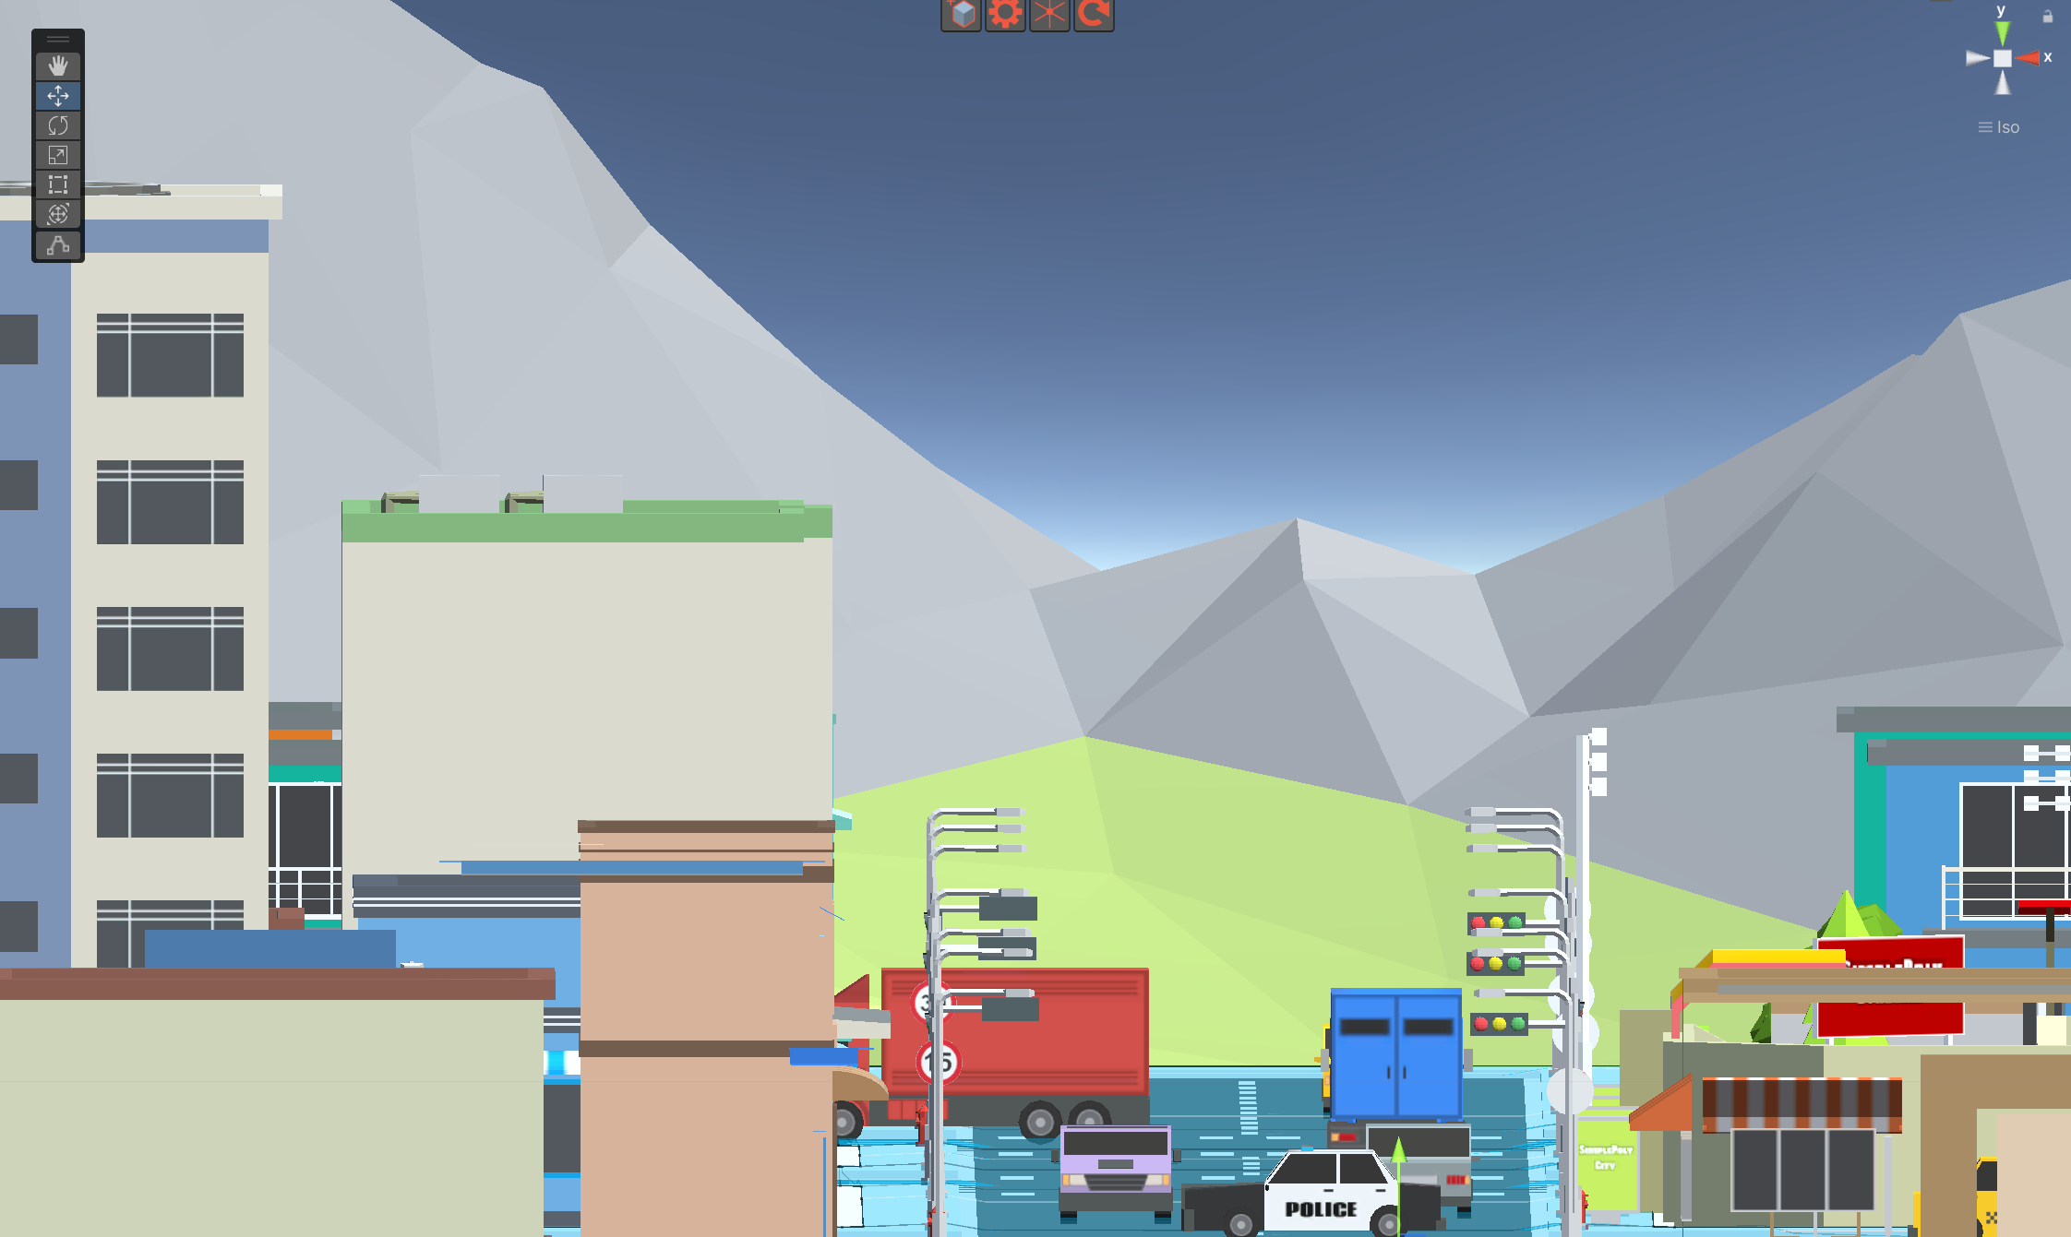
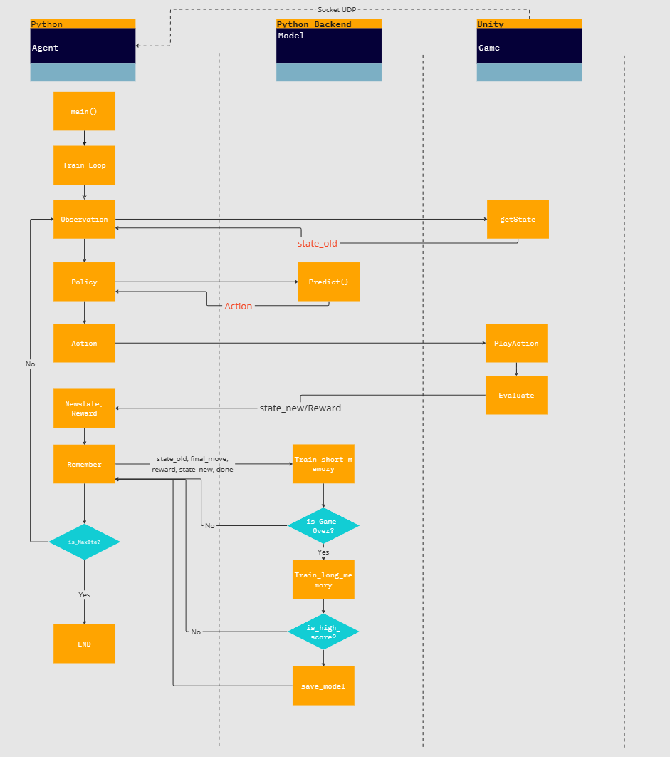

Slide 12
Process
Object Detection – Yolov8
Dataset preparation
Vision rendering
Augmentation (TBD)
Automatic image annotation
Dataset generating
Tools - Roboflow
Train
Test & Validate
Output (API)
from ultralytics import YOLO
# Load a model
model = YOLO('yolov8n.pt') # load a pretrained model (recommended for training)
# Train the model
results = model.train(data='coco8.yaml', epochs=100, imgsz=640)
# Run inference with the YOLOv8n model on the 'bus.jpg' image
results = model('path/to/bus.jpg')

Slide 13
Results & Conclusion
Virtual environment build
Vision data collection and auto-annotation
Object-detection model training
Batched training
One-frame training (online learning)
Object-detection model Validation
Virtual vision dataset validation
Physic world dataset validation

Slide 14
Limitation
Limited classes
To be improve: object occlusion issues
Computational power requirements
Potential errors (from virtual environment)

Slide 15
Future Development
Larger, realistic, & procedural world
Combining GIS (google earth / ArcGIS)
Sophisticated annotation
Physics Informed Machine Learning
Deployment (CPU/GPU/NPU Edge computing devices)

Slide 16
Issues and Leaning

Slide 17
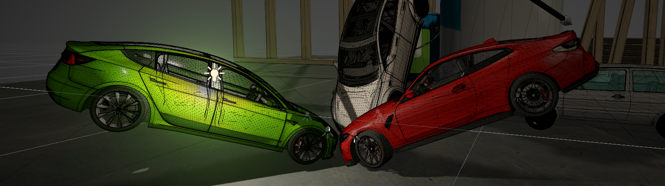

Issues & Lesson learned
Tech availability – lack of UI framework for Unity application
Appropriateness of tech-roadmap selection
Situation handling: Member absence & Contingent plan

